Slide 1
Milestone 2
CST-135 Matt SIevers

Slide 2
Design Notes
From a high level, changes needed to be made to the BaseContact as well as it’s children to support the creation of a new contact.
Added helper classes to the AddressBook class to access the list and perform simple actions.
Needed the FileAccessService to work as my “getter” for the list. Currently I am creating mock data within the class to prefill a list that I can then use the helper functions on from AddressBook.
BusinessContact was not tested, but is a direct duplicate of PersonContact.
Would like to add a type of contact to the list instead of a PersonContact or BuesinessContact. This will make more sense later to read from file where I need to just read a contact and that contact has a type object that can be assigned.

Slide 3
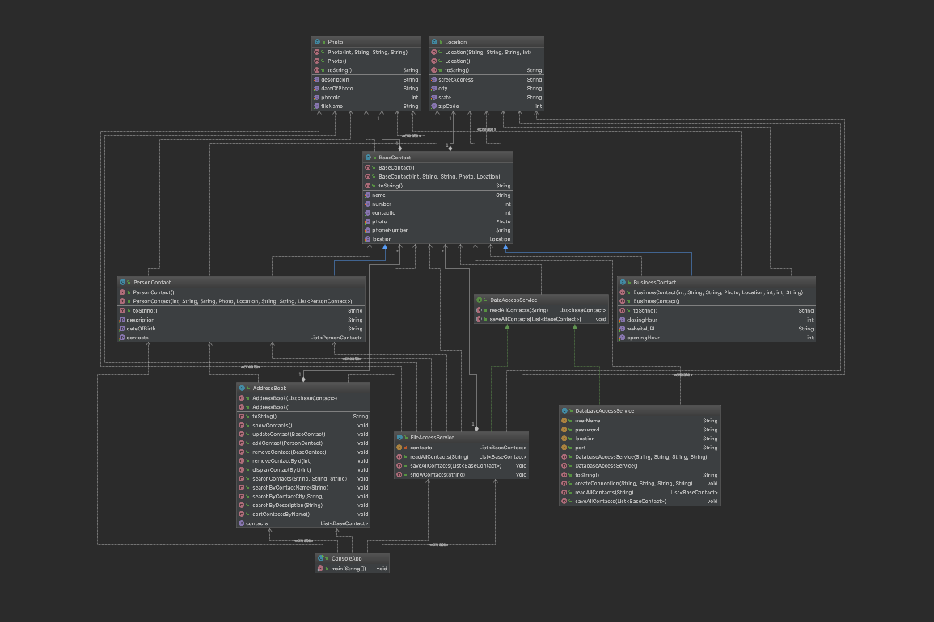
Updated UML

Slide 4
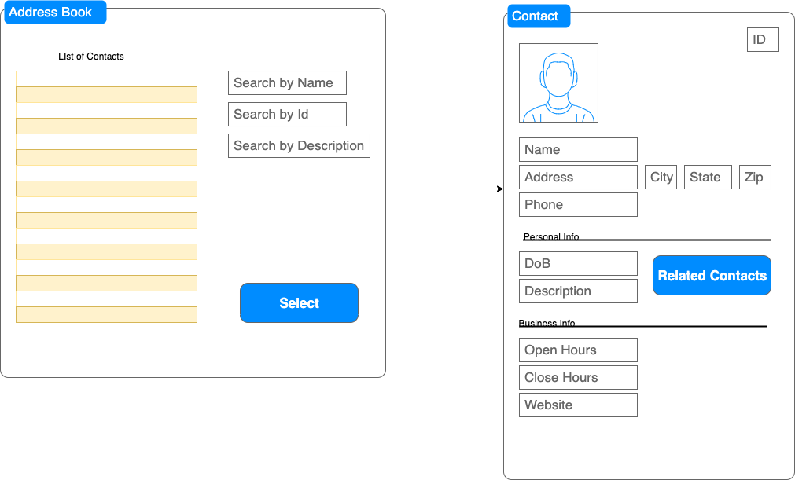
Wire Frame

